Slide 1
Air pollution in Temple Cloud

Slide 2
The Council’s responsibility…
Bath and North East Somerset Council is legally required to review air quality and if improvements are necessary, designate air quality management areas (AQMA), under Part IV of the Environment Act 1995 and the Air Quality (Standards) regulations;
Once declared, improvement must be demonstrated;

Slide 3
What pollutants do we monitor locally and why?
Nitrogen Dioxide (NO₂)- produced by the combination of oxides of Nitrogen and Oxygen in the atmosphere; significant source is from motor vehicles;
Why? Nitrogen dioxide is an irritant and can exacerbate existing respiratory conditions such as asthma

Slide 4
National Air Quality Objectives
National Air Quality Objective | Micrograms per metre cubed
Hourly | 200 (18 exceedences per year)
Annual Average | 40

Slide 5
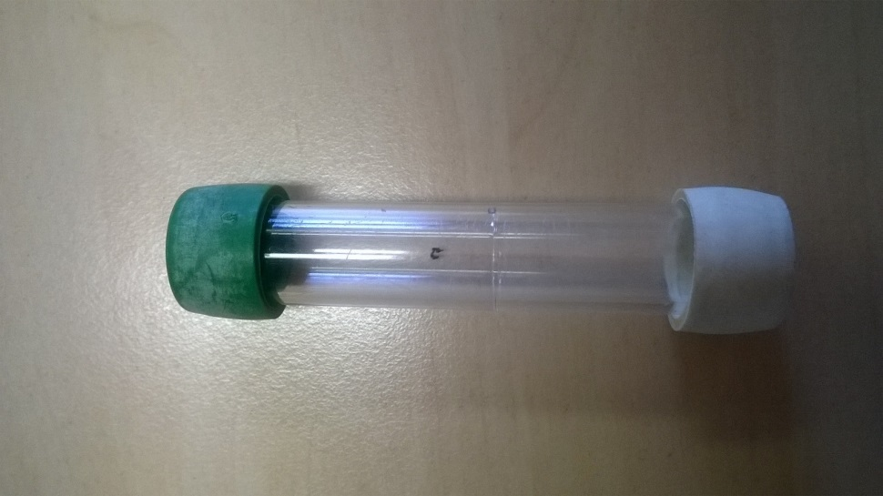
Our monitoring network for nitrogen dioxide: diffusion tubes
Monitors for NO₂
80+ locations throughout Bath & North East Somerset
5 locations in Temple Cloud in 2016
Changed on a monthly basis and provides monthly averages;

Slide 6
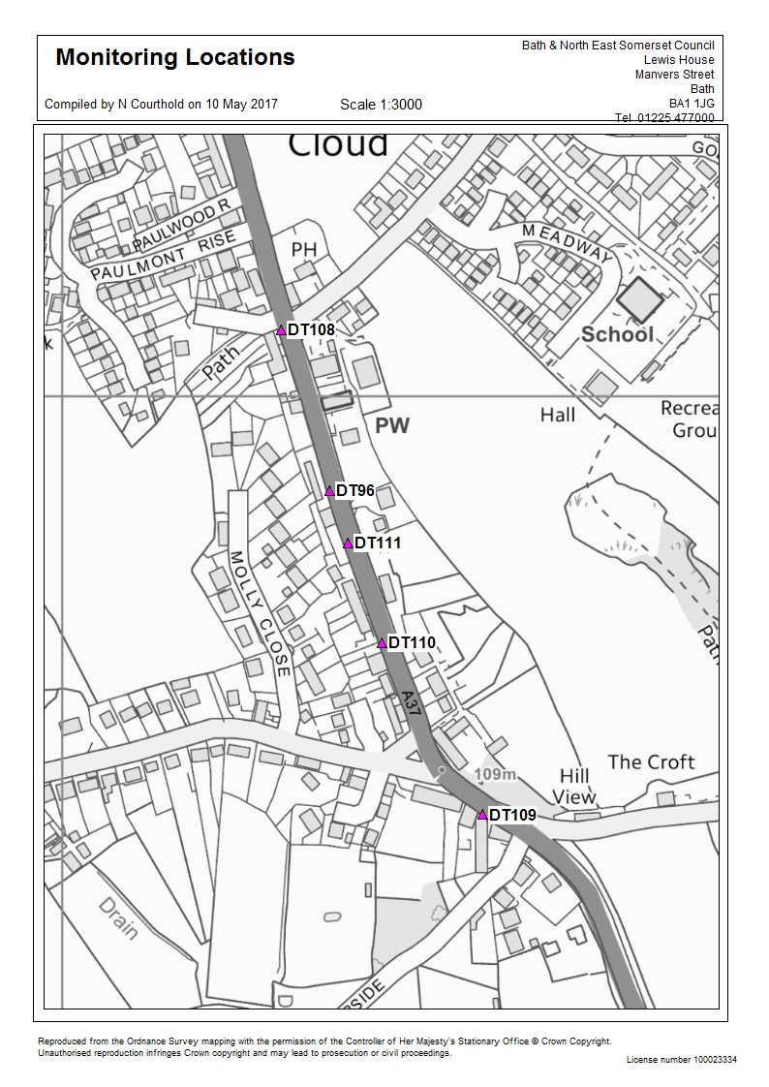
Monitoring of nitrogen dioxide
Site- Temple Cloud | Provisional data for 2016 | Provisional data At Façade
DT108 | 48 | 35
DT96 | 90 | 90
DT111 | 48 | 48
DT110 | 51 | 39
DT109 | 53 | 46
Note: Exceedances of the NO₂ annual mean objective of 40 µg/m³ are shown in bold. NO₂ annual means exceeding 60 µg/m³ indicating potential exceedances of the NO₂ 1-hour mean objective are shown in bold and underlined.
Results have been bias adjusted (0.99) and annualised (period to annual average)

Slide 7
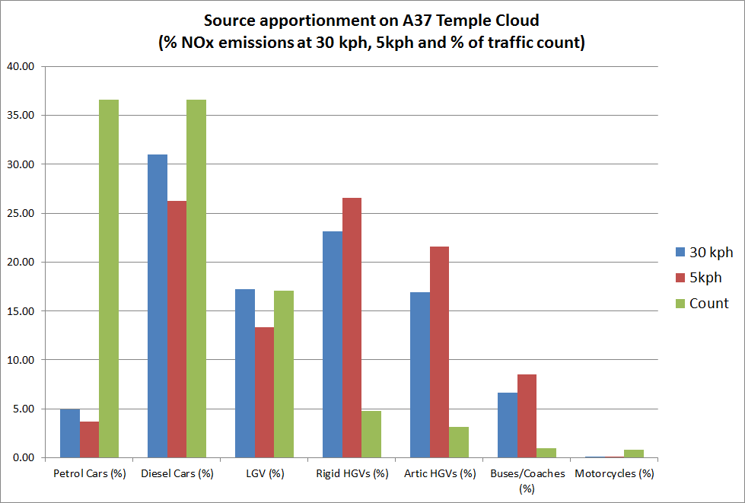
Source Apportionment

Slide 8
What next?
Declaring an Air Quality Management Area for Temple Cloud
Further monitoring to confirm boundary (May-Oct 2017)
Annual Status Report submitted to DEFRA on monitoring results (end June 2017)
Aim to consult with residents and statutory consultees on extent and boundaries of the AQMA (July-Sept 2017)
Decision confirmed by Executive Member or Cabinet (Oct 2017)
Legal process of declaration (Oct-Dec 2017)
Draw up Action Plan for Area to improve air quality in area (2018)
Notes:
Standard consultees: DEFRA, Surrounding LA, Highways England, Bodies representing local interests etc
Legal process of declaration – similar to a road traffic order, once approval from Council an order is drawn up, notice of intention to declare is advertised, order is sealed and a notice of making is advertised with a consultation period. Order comes into effect

Slide 9
Thank you for listening.
You can contact us at environmental_monitoring@bathnes.gov.uk
Thank you
Any questions?

